Slide 1
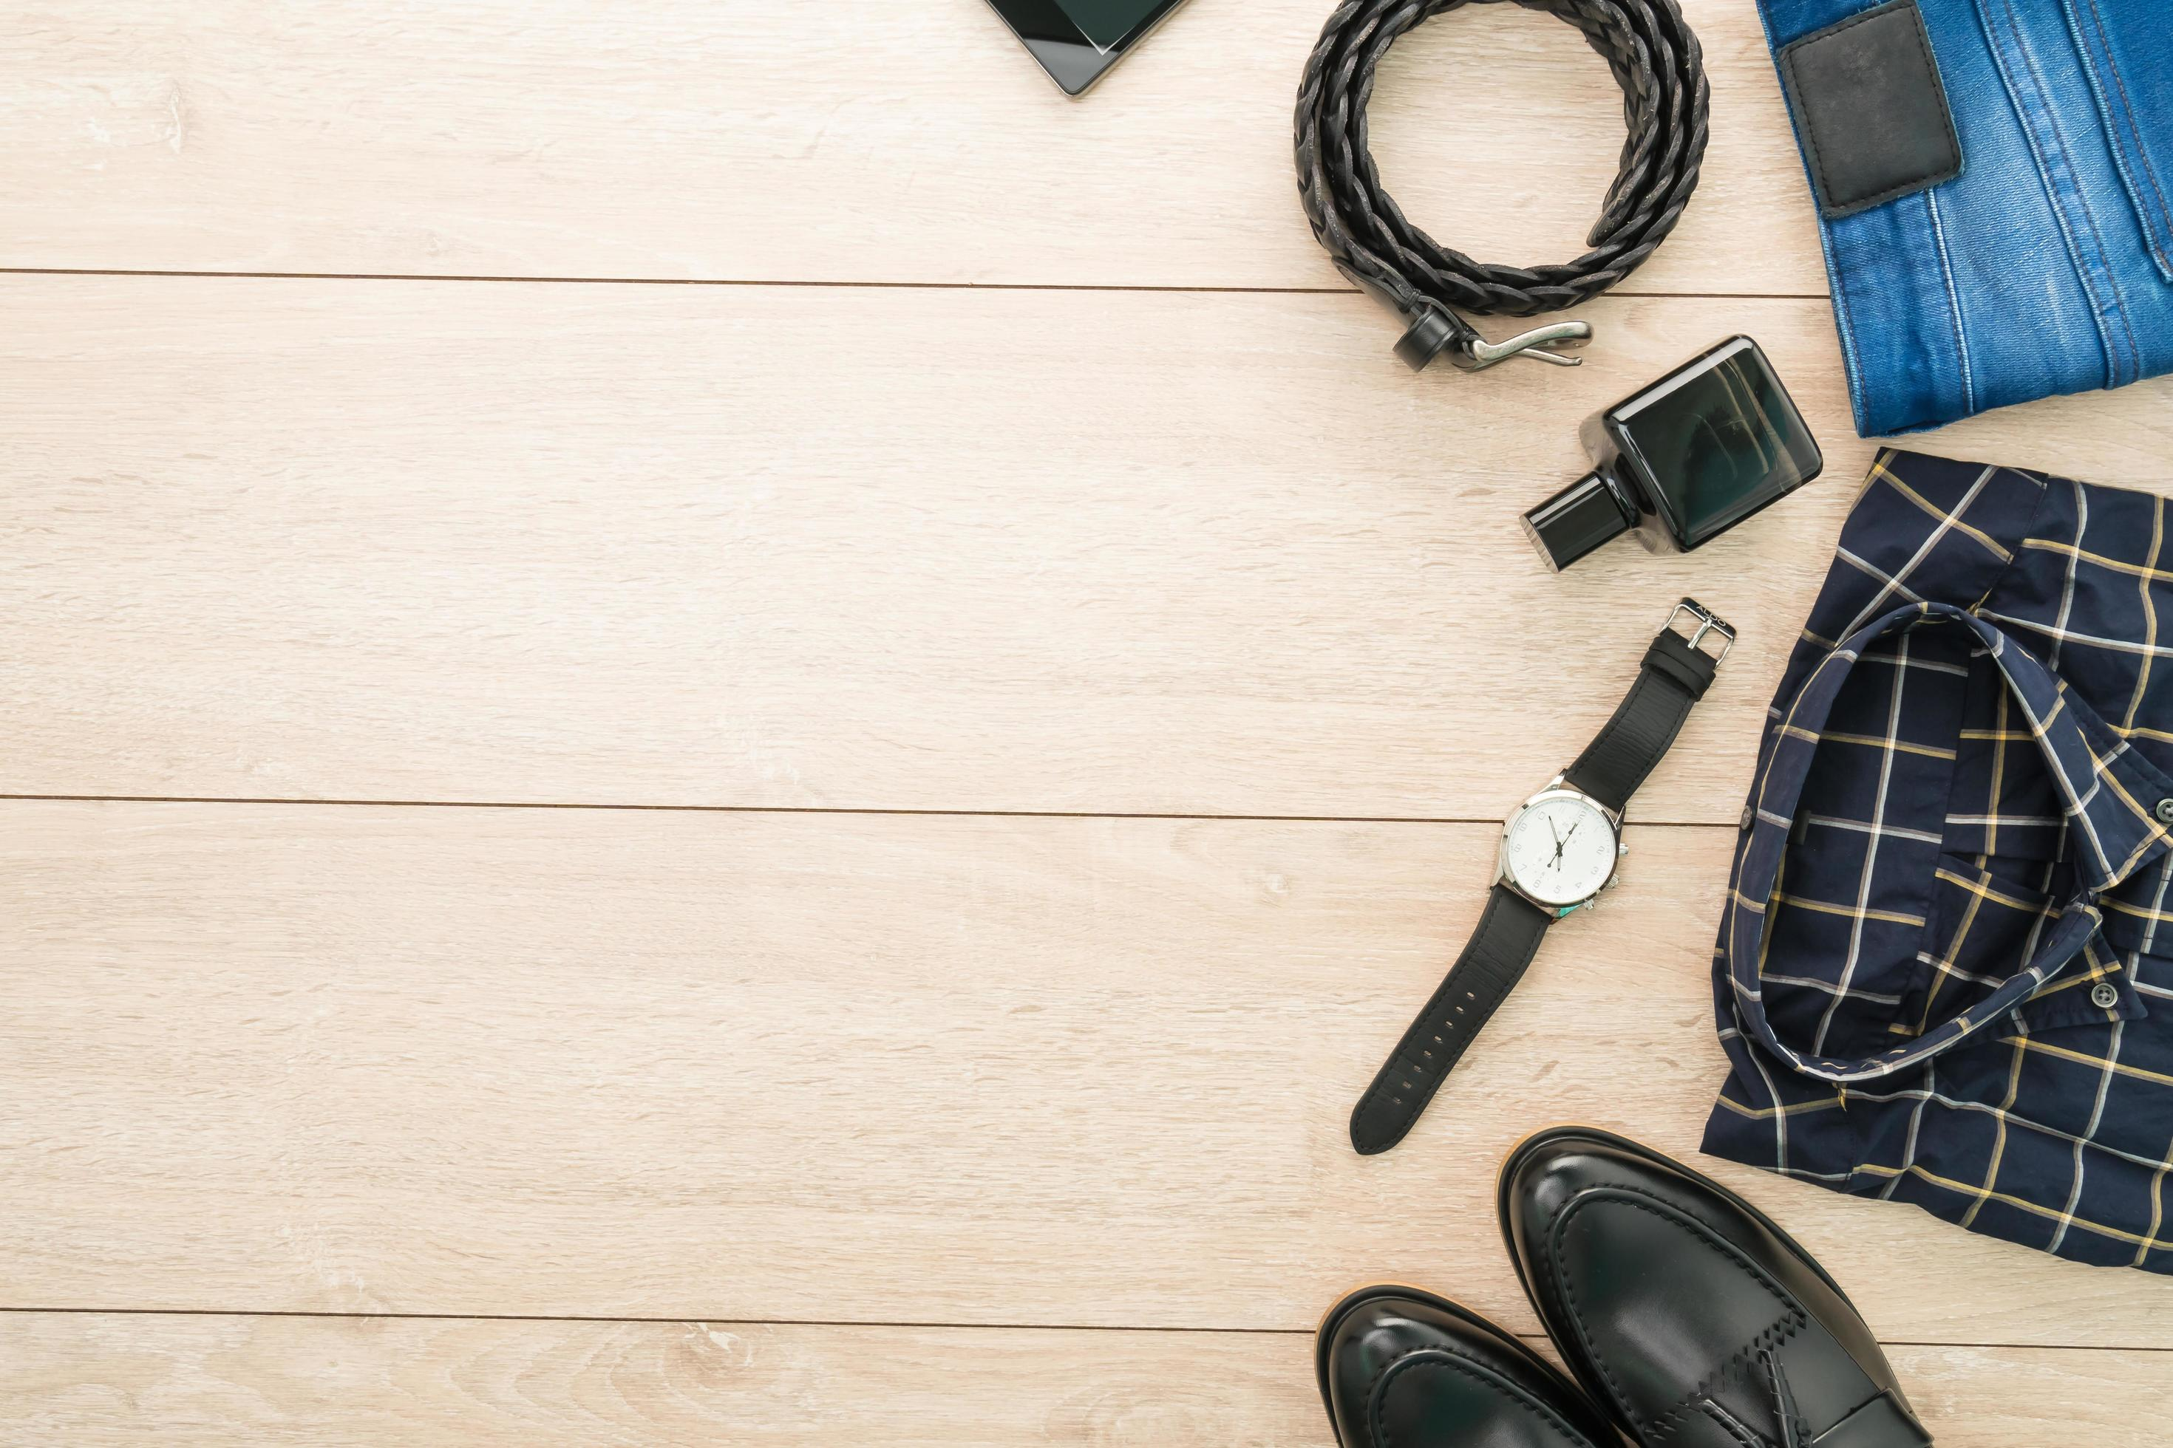
FASHION
FORWARD

Slide 2
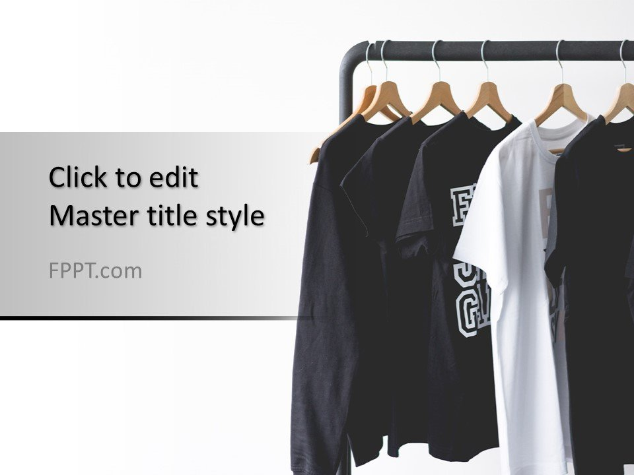
FIELD PROJECT (REVIEW – 01)
Presented by :
231FA04065-Narayana reddy
231FA04150-Bittu Lokesh Varma

Slide 3
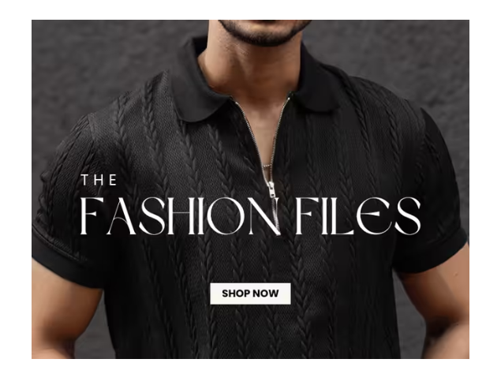
MOTIVE :
“FASHION FORWARD" PROJECT IS TO EXPLORE AND
PRESENT A COMPREHENSIVE OVERVIEW OF MEN'S CLOTHING, FOCUSING ON CONTEMPORARY
TRENDS, STYLES, AND CONSUMER PREFERENCES IN THE FASHION INDUSTRY.

Slide 4
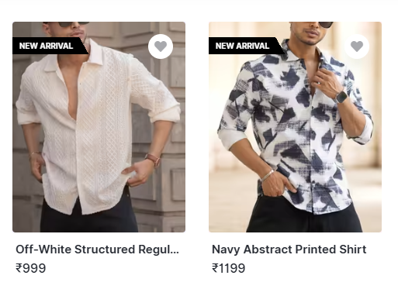
CATEGORIES OF CLOTHES
Casual Wear:- T-shirts- Jeans- Shorts- Casual shirts
Formal Wear:- Suits- Dress
shirts- Ties and accessories
Sportswear:-
Activewear- Joggers- Sports jackets 4.Outerwear:-Jackets- Coats- Hoodies
5. Footwear:- Sneakers- Formal
shoes- Casual loafers

Slide 5
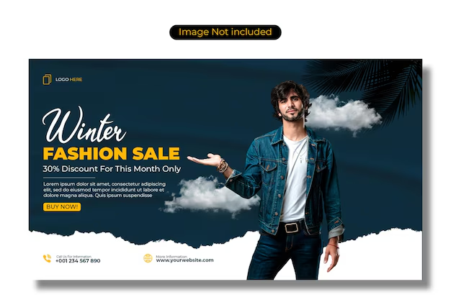
ADVANTAGES
Quality and Orderability: Emphasis on providing high-quality clothing at competitive prices, appealing to a wide demographic.
Fashion Accessibility: The project aims to make
fashionable clothing accessible to all
men, regardless of their style

Slide 6
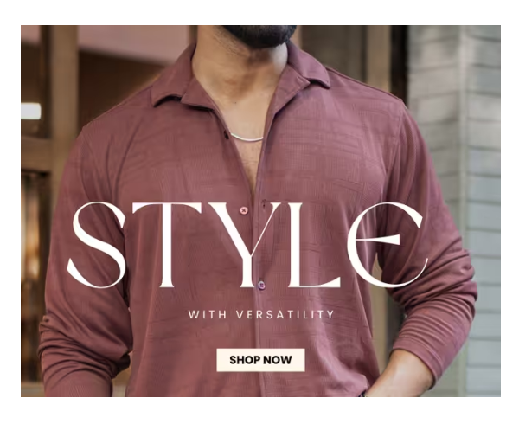
KEY FEATURES
-Diverse Product Range: The project will highlight various categories of men's clothing, ensuring a broad representation of styles.
- Trend Analysis: An in-depth analysis of current fashion trends and how they inﬂuence men's clothing choices.
- User Engagement: Strategies for engaging customers
through personalized shopping experiences and recommendations.

Slide 7
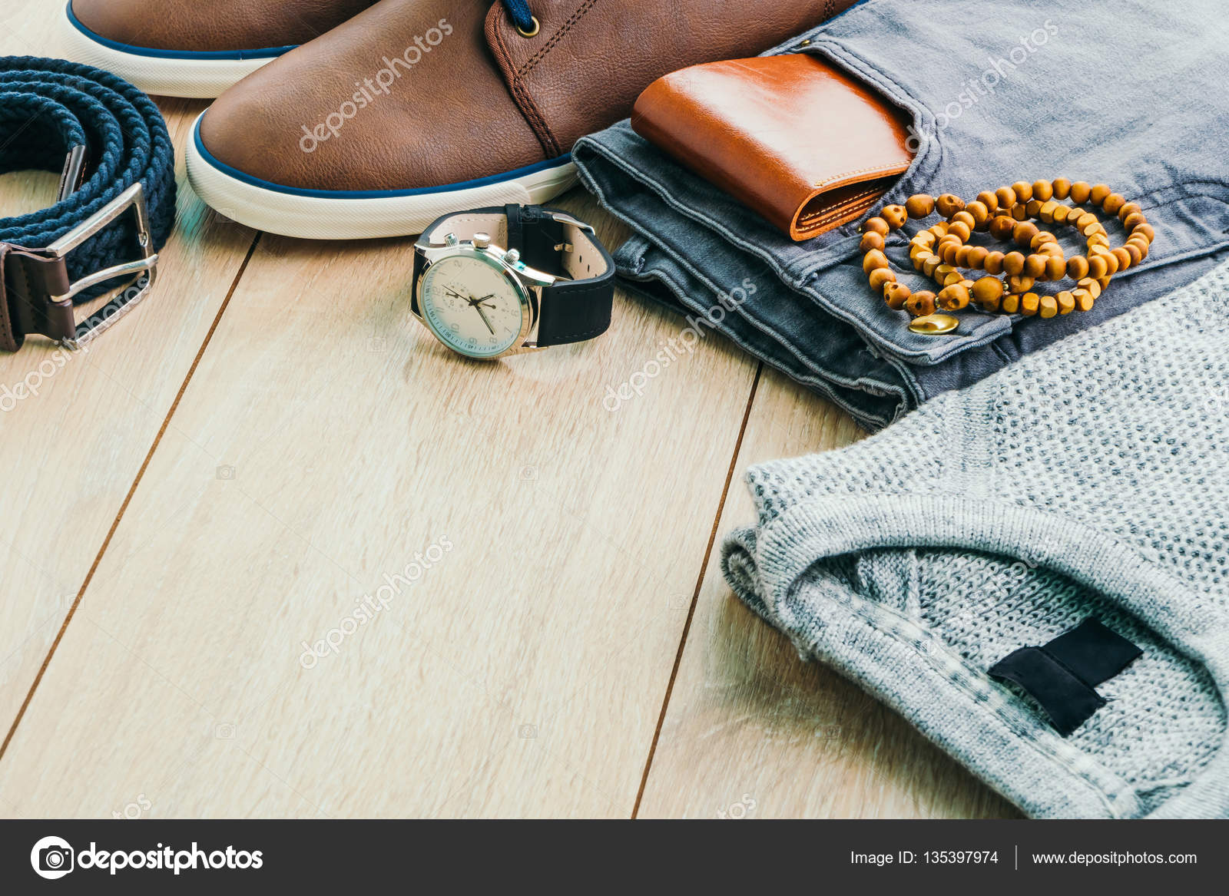
Literature Survey
INTRODUCTION
Powerlook's vision is centered around making high-quality fashion accessible to a broader audience. The brand offers a unique range of men's casual wear with a western touch, distinguishing itself from competitors by focusing on affordability without compromising quality. Their product lineup includes various styles such as shirts, t-shirts, joggers, and jackets
HTML5 contributes to faster page load times through its lightweight syntax and reduced reliance on external plugins. Features like asynchronous JavaScript loading prevent scripts from blocking page rendering, allowing users to interact with content more quickly, which is essential for retaining customers

Slide 8
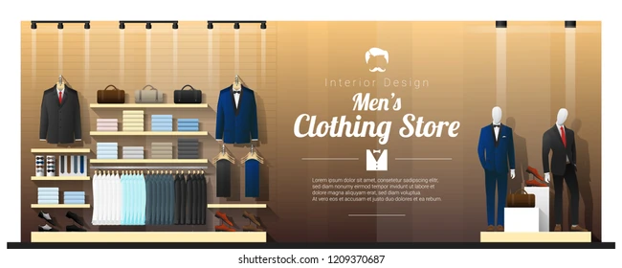
Methodology
HTML5 contributes to faster page load times through its lightweight syntax and reduced reliance on external plugins. Features like asynchronous JavaScript loading prevent scripts from blocking page rendering, allowing users to interact with content more quickly, which is essential for retaining customers.

Slide 9
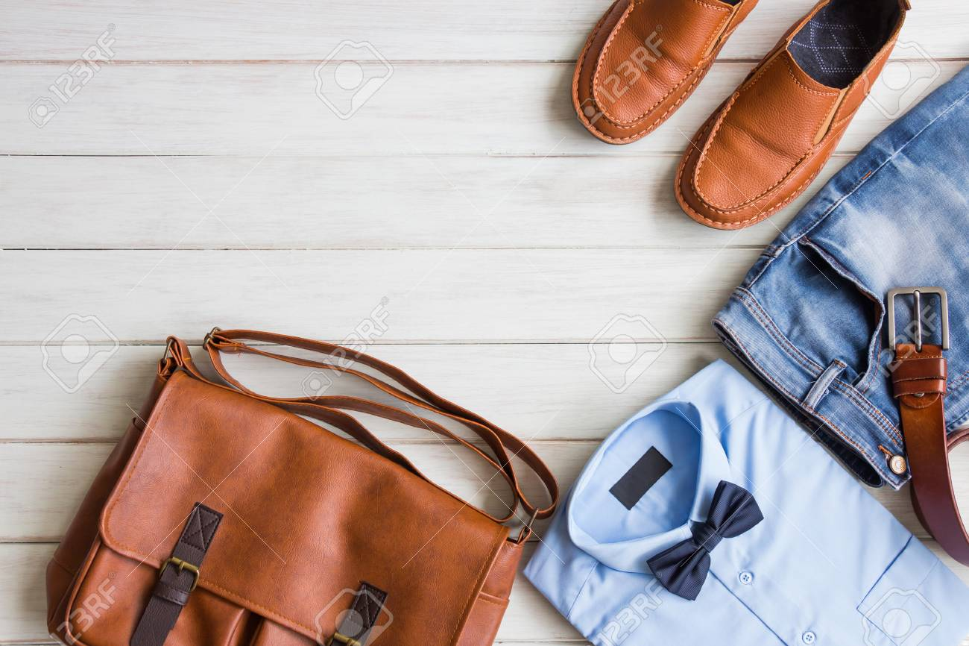
RESEARCH AND REFRENCES
consider these reference points based on
Fashion forward a user-friendly interface that enhances the shopping experience
Incorporate features that enhance user engagement and convenience
Integrate essential e-commerce features to facilitate smooth transactions
Maintain a strong brand presence through consistent visual elements
By focusing on these reference points, you can create a website that mirrors Powerlook's , Campusutra, e.t.c ., successful e-commerce platform while also enhancing user experience and engagement

Slide 10
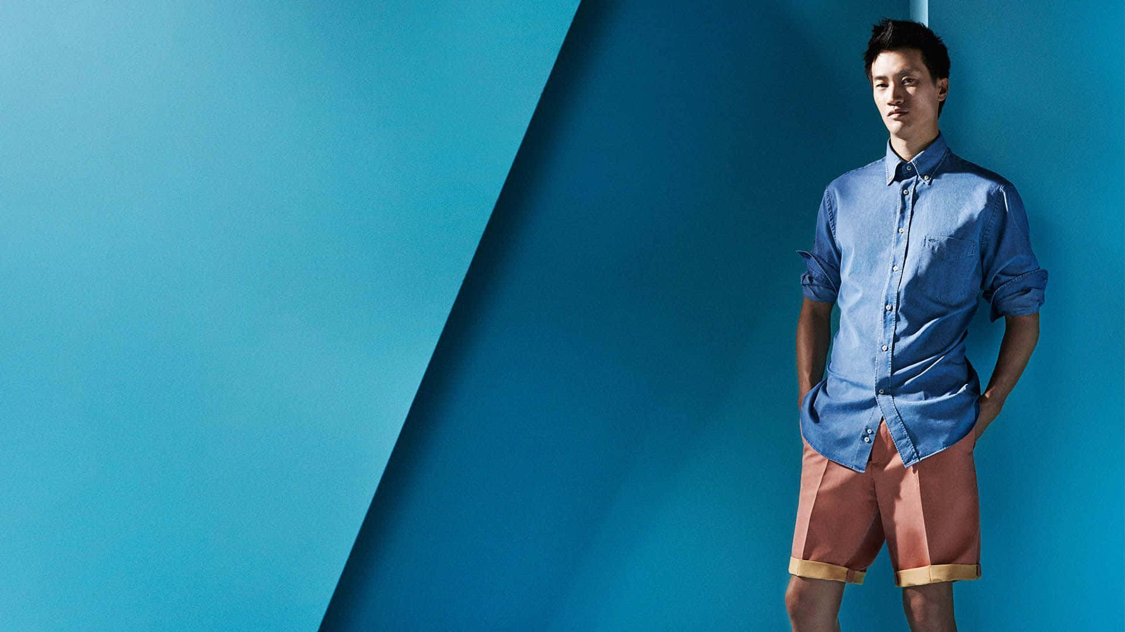
Finalization of Objectives
Primary Objectives : Create a user-friendly interface that mirrors
Power look aesthetic.
Implement essential e-commerce features (shopping cart, payment processing).
Ensure mobile responsiveness and fast load times.

Slide 11

Basic Model Features
Core Functionalities:User registration and profile management.
Product catalog with filtering options.
Shopping cart functionality with secure checkout process.
Additional Features:Customer reviews and ratings system.
Integration of social media for marketing purposes.

Slide 12

<!DOCTYPE html>
<html lang="en">
<head>
<title>FASHION FORWARD (where style meets comfort)</title>
<link rel="stylesheet" href="https://cdn.jsdelivr.net/npm/bootstrap@5.3.2/dist/css/bootstrap.min.css">
<link rel="stylesheet" href="event-styles.css">
</head>
<body>
<header class="bg-dark text-white text-center py-3">
<section id="FASHION FORWARD" class="py-5">
<div class="container">
<h2 class="text-center mb-3">FASHION FORWARD</h2>
<p>Style Meets Comfort</p>
</header>
<nav class="navbar navbar-expand-lg navbar-dark bg-dark">
<a class="navbar-brand" href="#">Fashion Forward</a>
<button class="navbar-toggler" type="button" data-toggle="collapse"
data-target="#navbarNav" aria-controls="navbarNav"
aria-expanded="false" aria-label="Toggle navigation">
<span class="navbar-toggler-icon"></span>
</button>
<div class="collapse navbar-collapse" id="navbarNav">
<ul class="navbar-nav ml-auto">
<li class="nav-item active">
<a class="nav-link" href="#details">Collections</a>
</li>
<li class="nav-item">
<a class="nav-link" href="#speakers">Offer zone</a>
</li>
<li class="nav-item">
<a class="nav-link" href="loginp.html">Register</a>
</li>
<li class="nav-item">
<a class="nav-link" href="cart.html">cart</a>
</li>
</ul>
</div>
</nav>

Slide 13

<main>
<section id="Shirts" class="py-5">
<div class="container">
<h2 class="text-center mb-3" >Shirts</h2>
<button class="arrow right" onclick="moveSlide(1)">
<a class="nav-link" href="shirts.html">Shirts</a>
&#10095;
</button>
<a class="nav-link" href="shirts.html"></a>
</div>
</section>
<hr>
<section id="T-Shirts" class="py-5 bg-light">
<div class="container">
<h2 class="text-center mb-3">T-Shirts</h2>
<button class="arrow right" onclick="moveSlide(1)">
<a class="nav-link" href="T-Shirts.html">T-Shirts</a>
&#10095;
</button>
<a class="nav-link" href="T-Shirts.html"></a>
</div>
</section>
<hr>
<hr>
<br>
<br>
<div class="btn-block text-center all-product" style="user-select: auto;">
<a class="btn-border" href="/product-category/freshnew-arrivals" style="user-select: auto;">
<span style="user-select: auto;">View ALL Products</span>
<i class="fas fa-arrow-right fa-lg pl-2" style="user-select: auto;"></i>
</a>
</div>
<br>
<br>
<footer class="bg-dark text-white text-center py-3">
<p>© 2025. Fashion Forward, Always !!</p>
</footer>
</body>
</html>

Slide 14
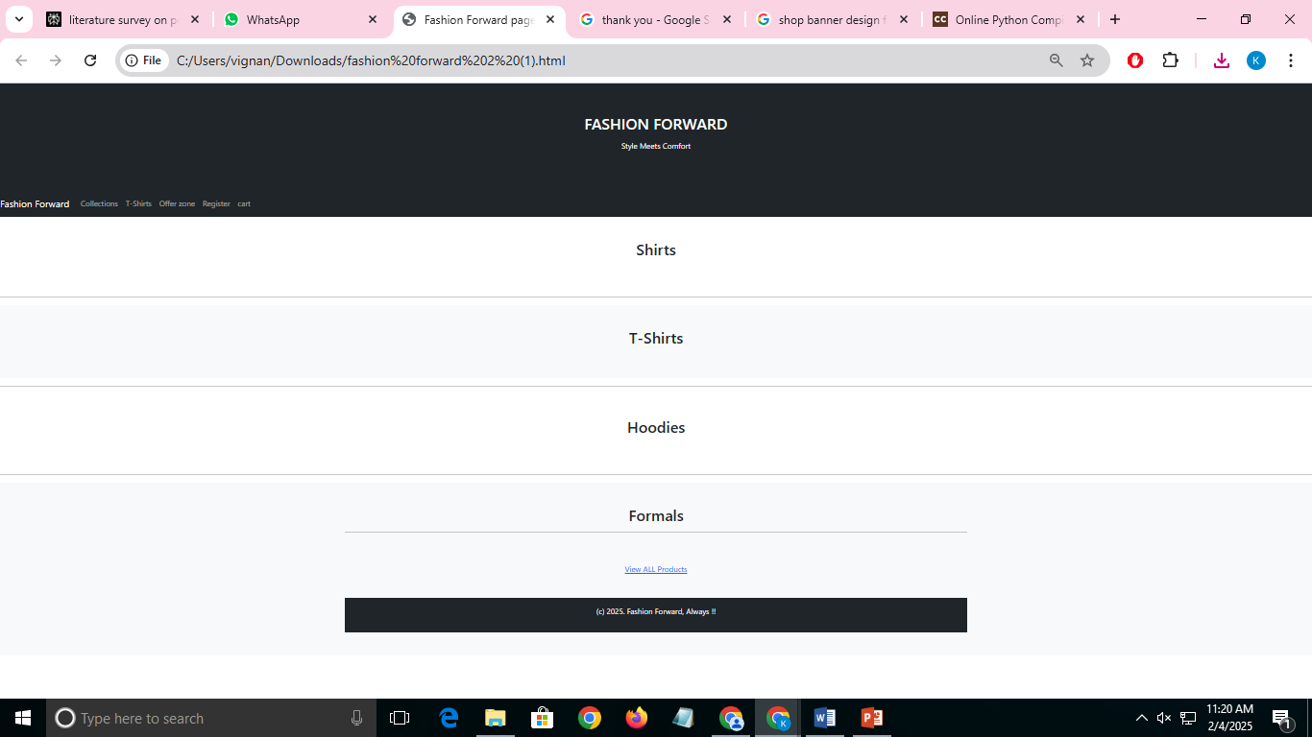

Slide 15
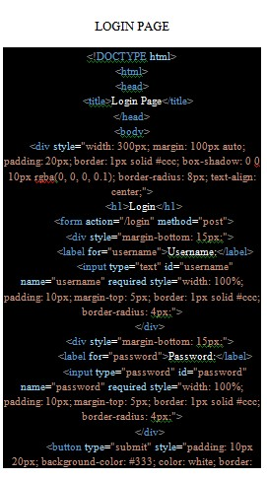
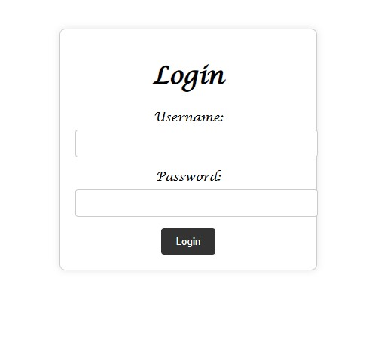
LOGIN PAGE

Slide 16
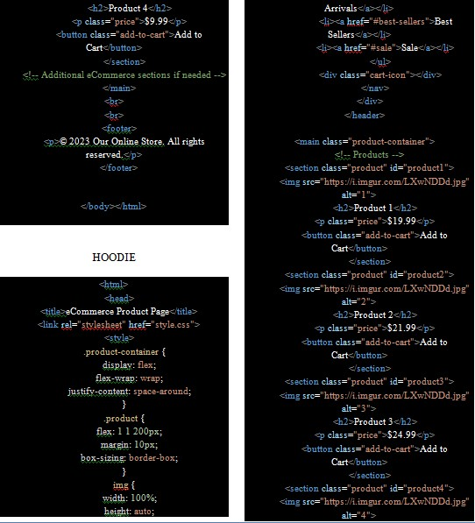
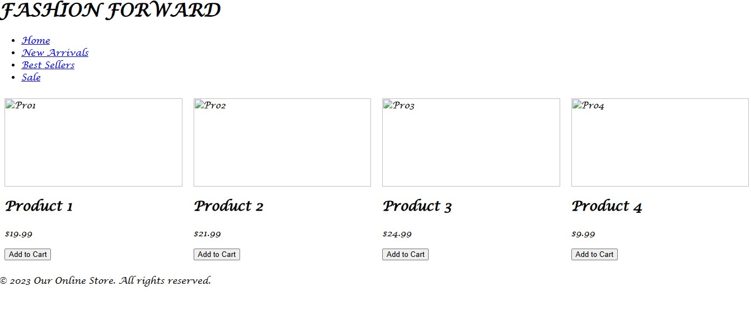
HOODIE

Slide 17
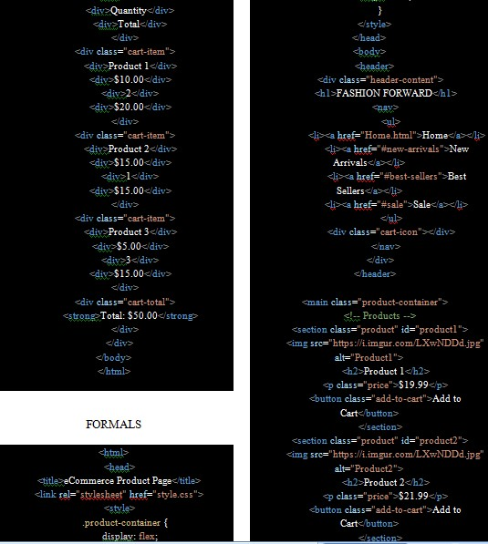
FORMALS

Slide 18
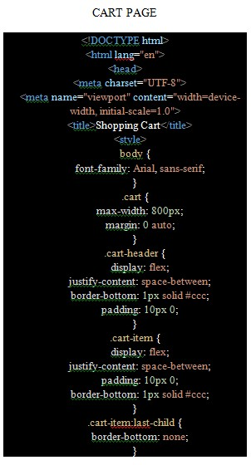
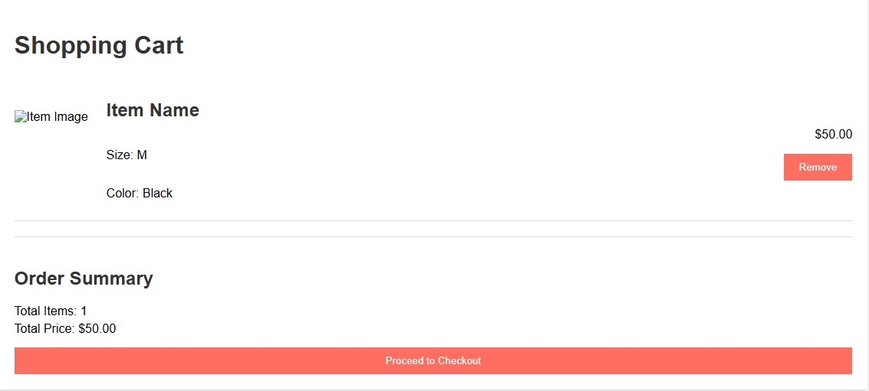
CART

Slide 19
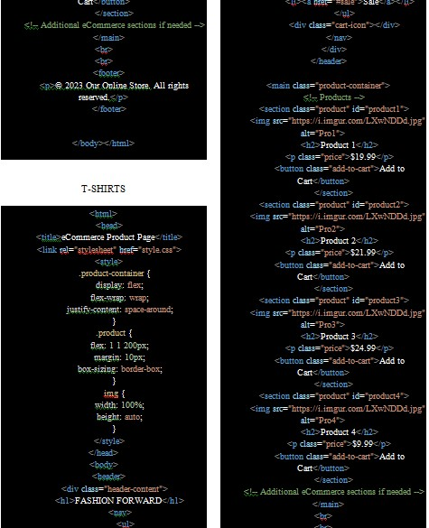
T-SHIRTS

Slide 20
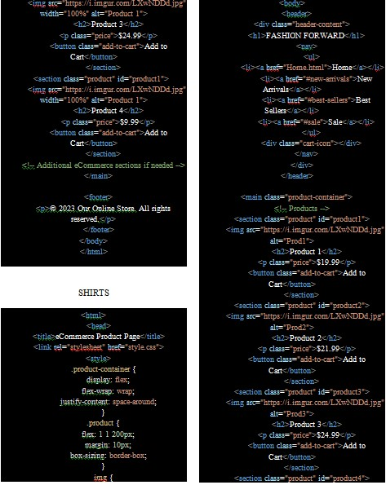
SHIRTS

Slide 21
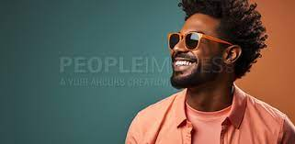
Conclusion
:Summary of progress made towards achieving project objectives.
Reiteration of the importance of creating a competitive e-commerce platform that meets user needs.
This structure provides a comprehensive overview while allowing room for detailed discussion during your presentation. Adjust content as necessary to fit your specific findings and project details.

Slide 22
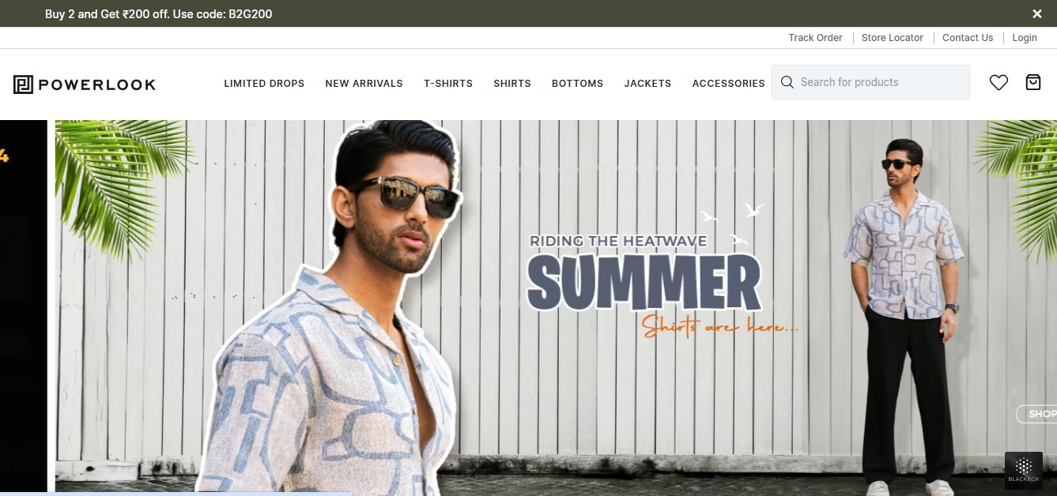
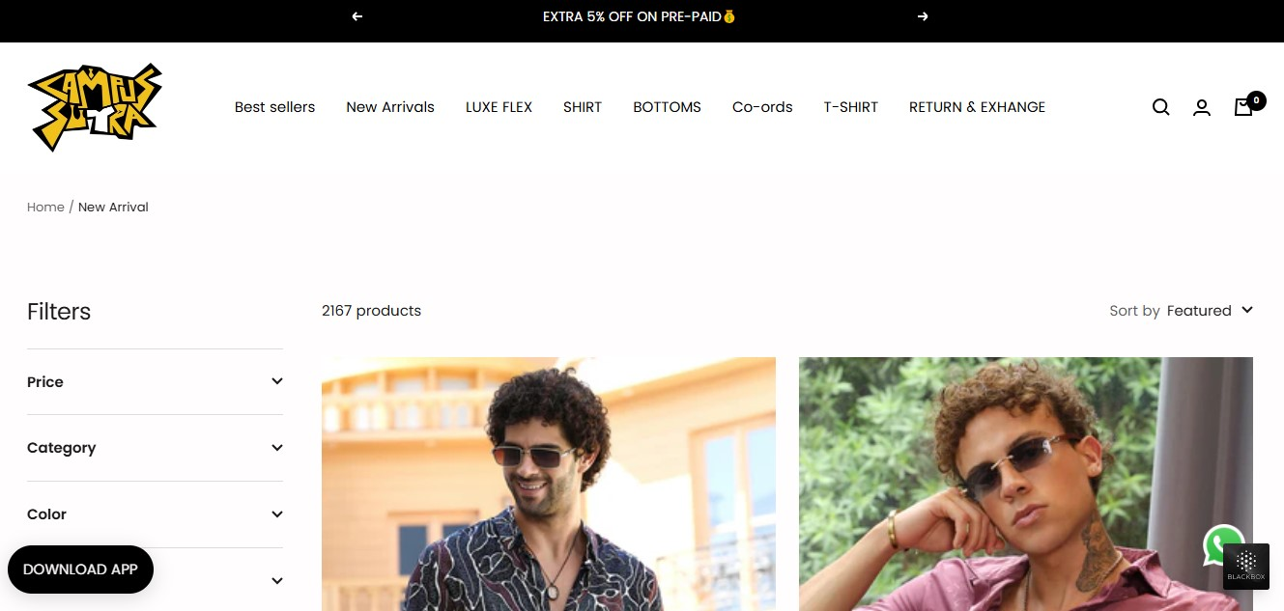
References:-
Got it! Here are some references from fashion websites like Powerlook, Campustura, and Denim that you can include in your slide:
1. **Powerlook**: "Empower Your Look" - Powerlook offers a wide range of trendy men's clothing, including jackets, shirts, t-shirts, denim jeans, joggers, and more. Their website emphasizes premium quality products and secure payments.
2. **Campustura**: "Youth Fashion" - Campustura is a youth brand that creates merchandise based on the slice of life of a young person in India. They offer a variety of clothing options for both men and women, including t-shirts, shirts, jeans, cargo pants, activewear, and more.

Slide 23


